Slide 1

WiFi-AC Project
Lior Yaacov

Slide 2

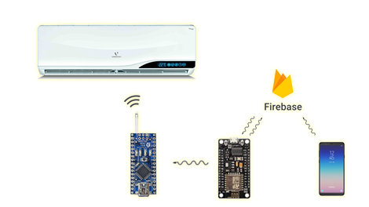
Agenda
Introduce WiFi-AC Project
Introduce the project’s sub-systems
Google’s Firebase
MIT App Inventor
Eagle PCB
The Code
Test the system
Conclusion

Slide 3
Main idea
The main idea behind this project is to make our home smarter. That means that every element we have can be connected to an app and can be controlled from distance. This project starts with the AC, because it contains sending an IR codes and using database and much more complex than just turn switch on or off, but the idea is to continue and make all elements at home able to connect to the internet and therefore be controlled with a smartphone app.

Slide 4
WiFi-AC sub systems
When the user click on a button, a long sequence is starting. Delivering the user’s order from the smartphone all over the way to the AC requires a cooperation of 4 systems:
The smartphone app
Firebase DB
The main circuit – powered by ESP
The transmitter circuit – powered by Arduino Nano

Slide 5

MIT App inventor
MIT App Inventor is an open-source web application originally provided by Google, and now maintained by the Massachusetts Institute of Technology (MIT).
MIT allows new programmer to create software application for the Android OS. It has a graphical interface which allows users to drag-and-drop blocks of codes to create a functional application that can run on an Android device.

Slide 6
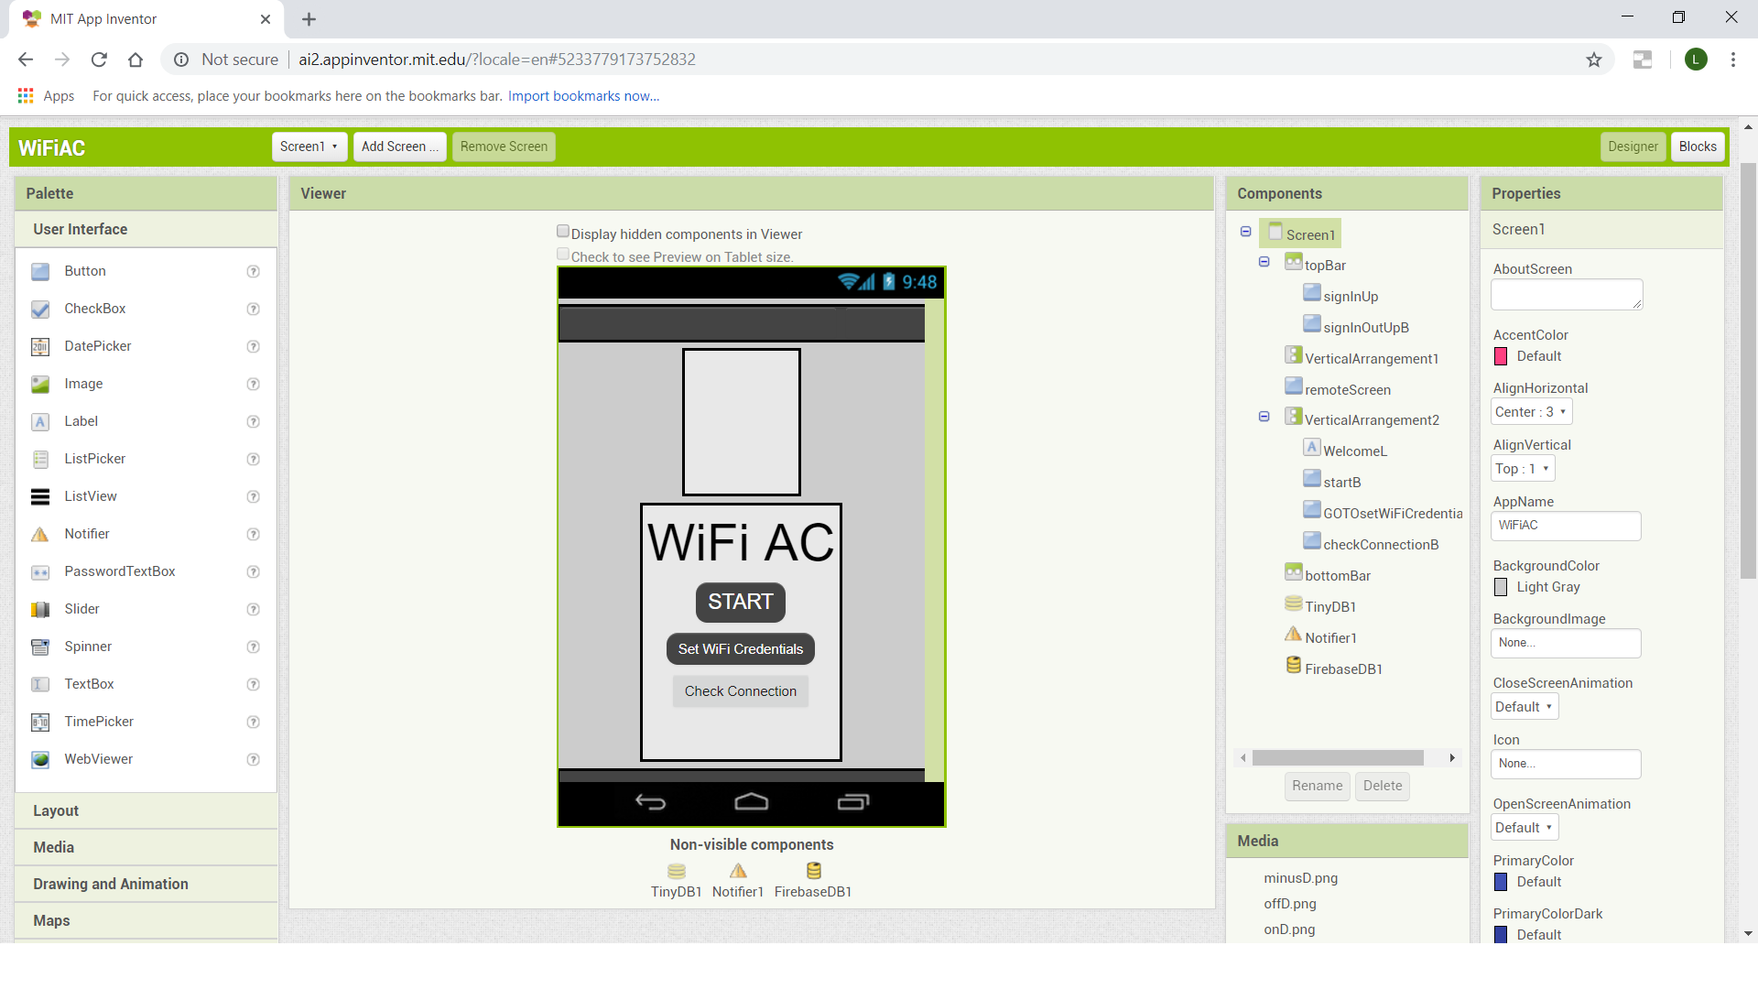
MIT APp inventor

Slide 7

Google Firebase
Firebase is a backend-as-a-Service (BaaS) that started as a YC11 Startup and grew up into a next-generation app-development platform on Google Cloud Platform.
Firebase frees developers to focus crafting fantastic user experiences. Normally you need to manage servers and write APIs, but when it comes to Firebase – Firebase itself is your server, API and datastore, and all written so generically that you can modify it to suit most needs.

Slide 8
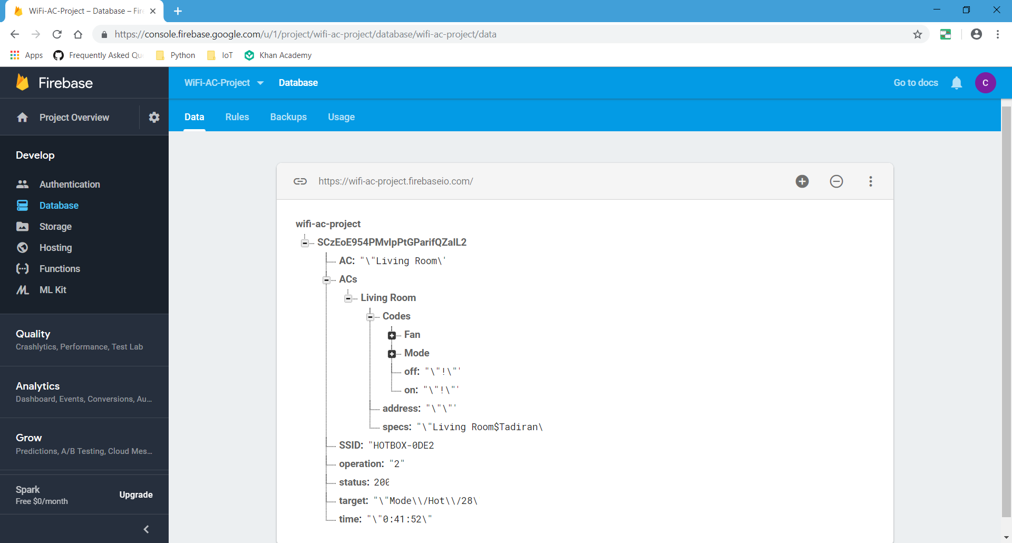
Google firebase

Slide 9

Eagle
EAGLE stands for Easily Applicable Graphical Layout Editor and is developed by CadSoft Computer GmbH. The company was acquired by Autodesk Inc. in 2016.
EAGLE is a scriptable electronic design automation (EDA) application with schematic capture, printed circuit board (PCB) layout, auto-router and computer-aided manufacturing (CAM) features.

Slide 10
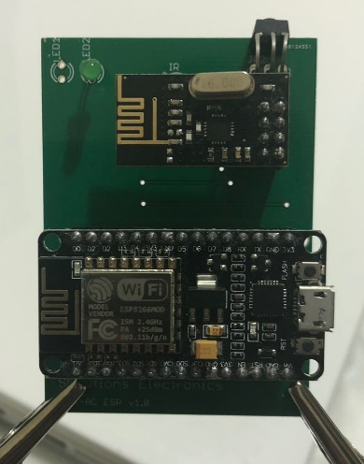
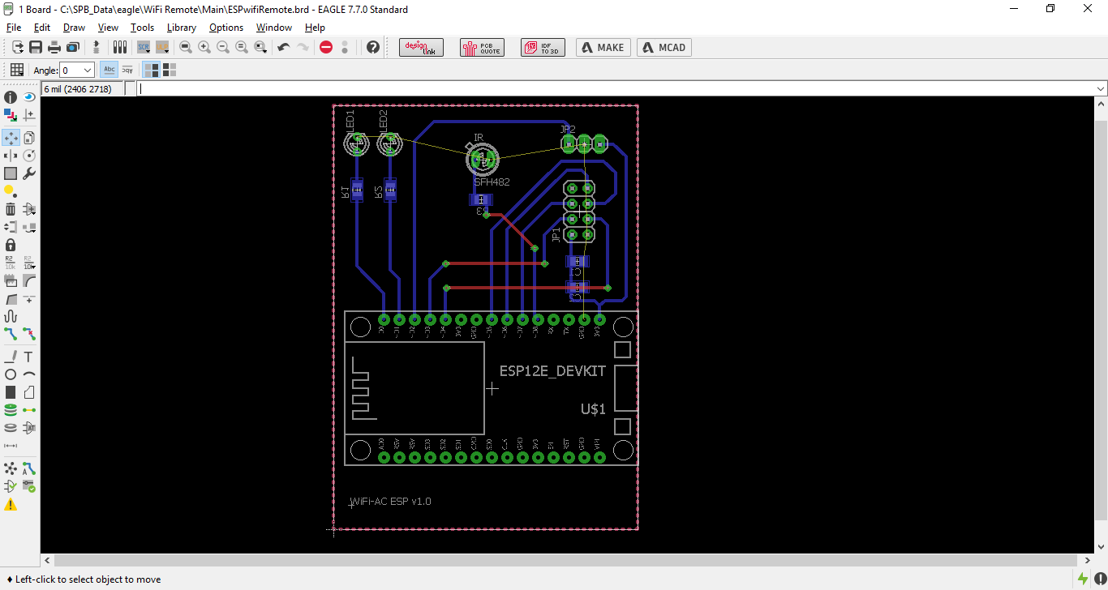
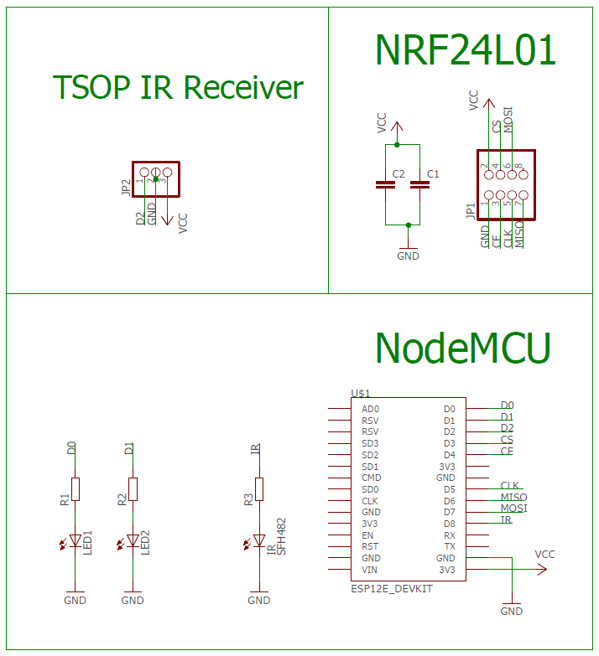
Eagle

Slide 11
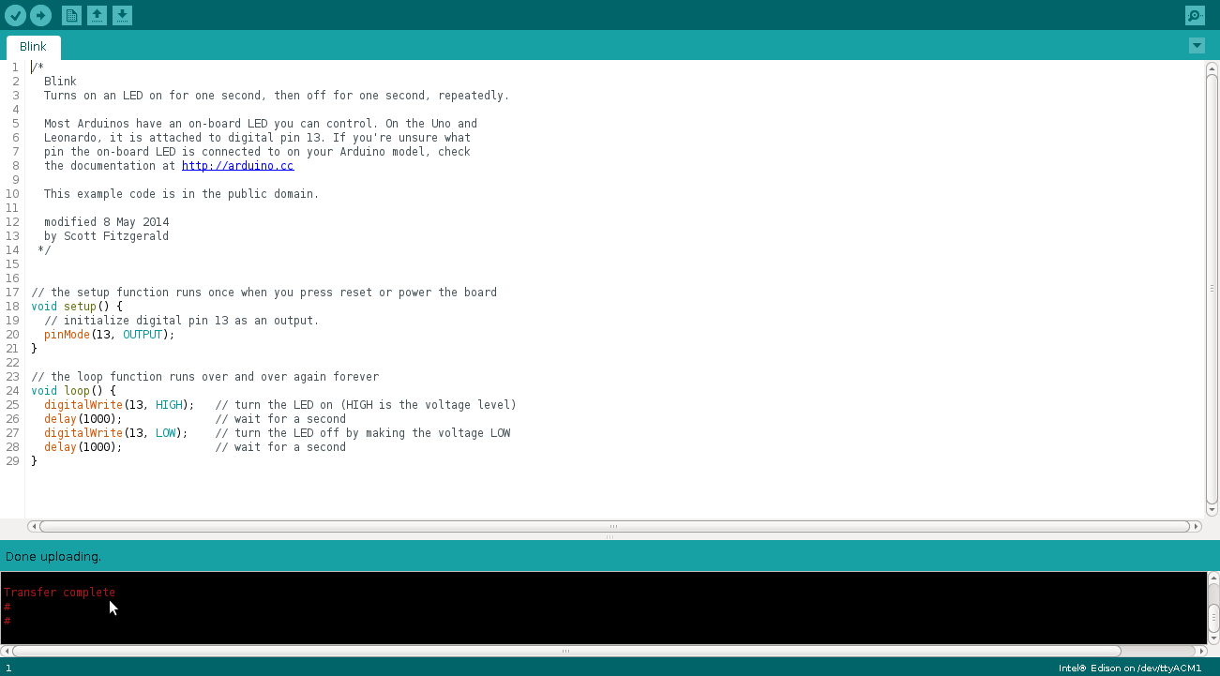
The code

Slide 12

The Code
The code for both circuits is written in C++ using the Arduino’s IDE
The code is using different libraries. Some are a part of the Arduino’s IDE and some are open source libraries from the IoT community

Slide 13
Arduino’s Libraries
ESP8266
EEPROM
WiFi-AC
IRremote
SPI
RF24

Slide 14

Testing the system
Reset WiFi Credentials
Link new WiFi spot
Create new AC
Record new code
Send the code using Firebase
Send the code using the app

Slide 15

conclusion
WiFi-AC Project is the first step in creating a full automated home
The fact we start with an AC is an important step in this target
The vision of this project is to eliminate the use of remote controls and activate everything using the smartphone, from any place on earth

Slide 16
WiFi-AC PROJECT
The End

